Slide 1
Sleep Macrostructure Analysis
2025. 12. 17
Dongjae Seo

Slide 2
Sleep Macrostructure
Sleep Macrostructure
  Overall overnight sleep structure and distribution
  Reference: Mander BA, Winer JR, Walker MP. Sleep and Human Aging. (Neuron. 2017)
  Differences in sleep macrostructure based on individual characteristics (age, gender, etc.)
  Analysis:
  Based on PhysioNet Annotations
  Analysis of factors influencing sleep macrostructure discussed in prior literature
  Early / Late Cycle
  Age
  Gender
  BMI (Observatory)

Slide 3
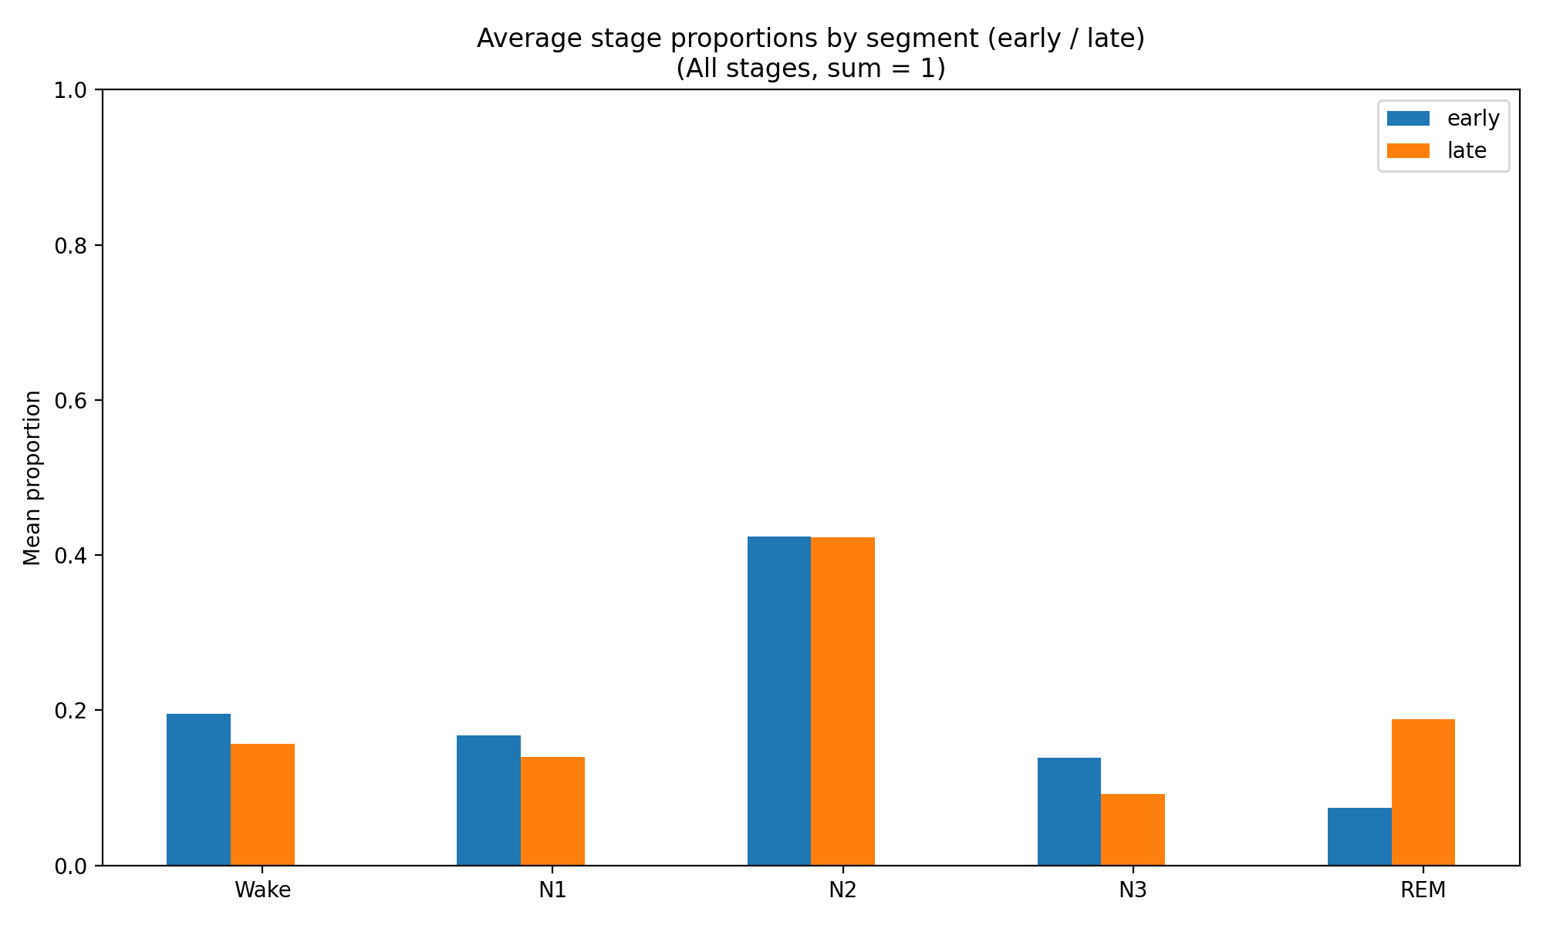
Sleep Macrostructure
Early / Late Cycle
  Early Sleep: Higher N3 proportion
  Late Sleep: Increased REM proportion
PhysioNet : 991 patients
N3(%):
13.9 -> 9.2
REM(%):
7.4 -> 18.9
Early / Late Sleep - Stage Proportion Plot

Slide 4
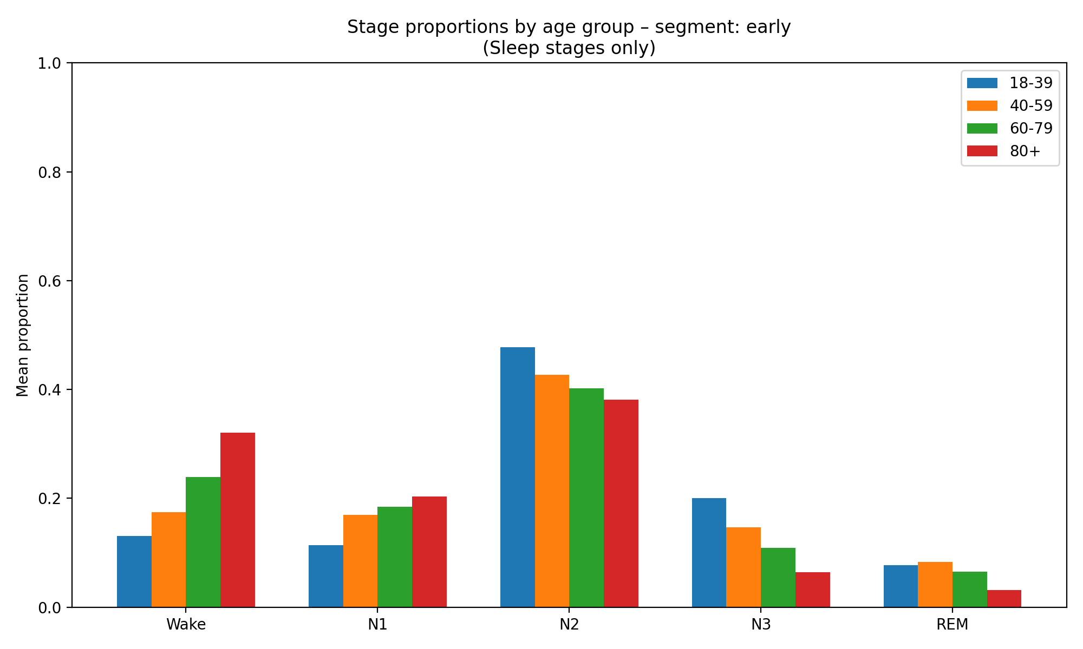
Sleep Macrostructure
Macrostructure change with Age
  Age as a Major Factor influencing Sleep Macrostructure
  As Age increases:
    Total Sleep Time decreases
    Sleep Fragmentation increases
    Deeper NREM (N3) decreases
  Observation:
  Increased proportion of Wake in the aged group, indicating greater fragmentation
  Reduction in N3, particularly during early sleep
  Age-related trends persist during late sleep as well
PhysioNet - Early
18-39 : 148 patients
40-59 : 451 patients
60-79 : 366 patients
80+ : 26 patients
= 991 Patients
Age group - Stage Proportion Plot (Early)

Slide 5
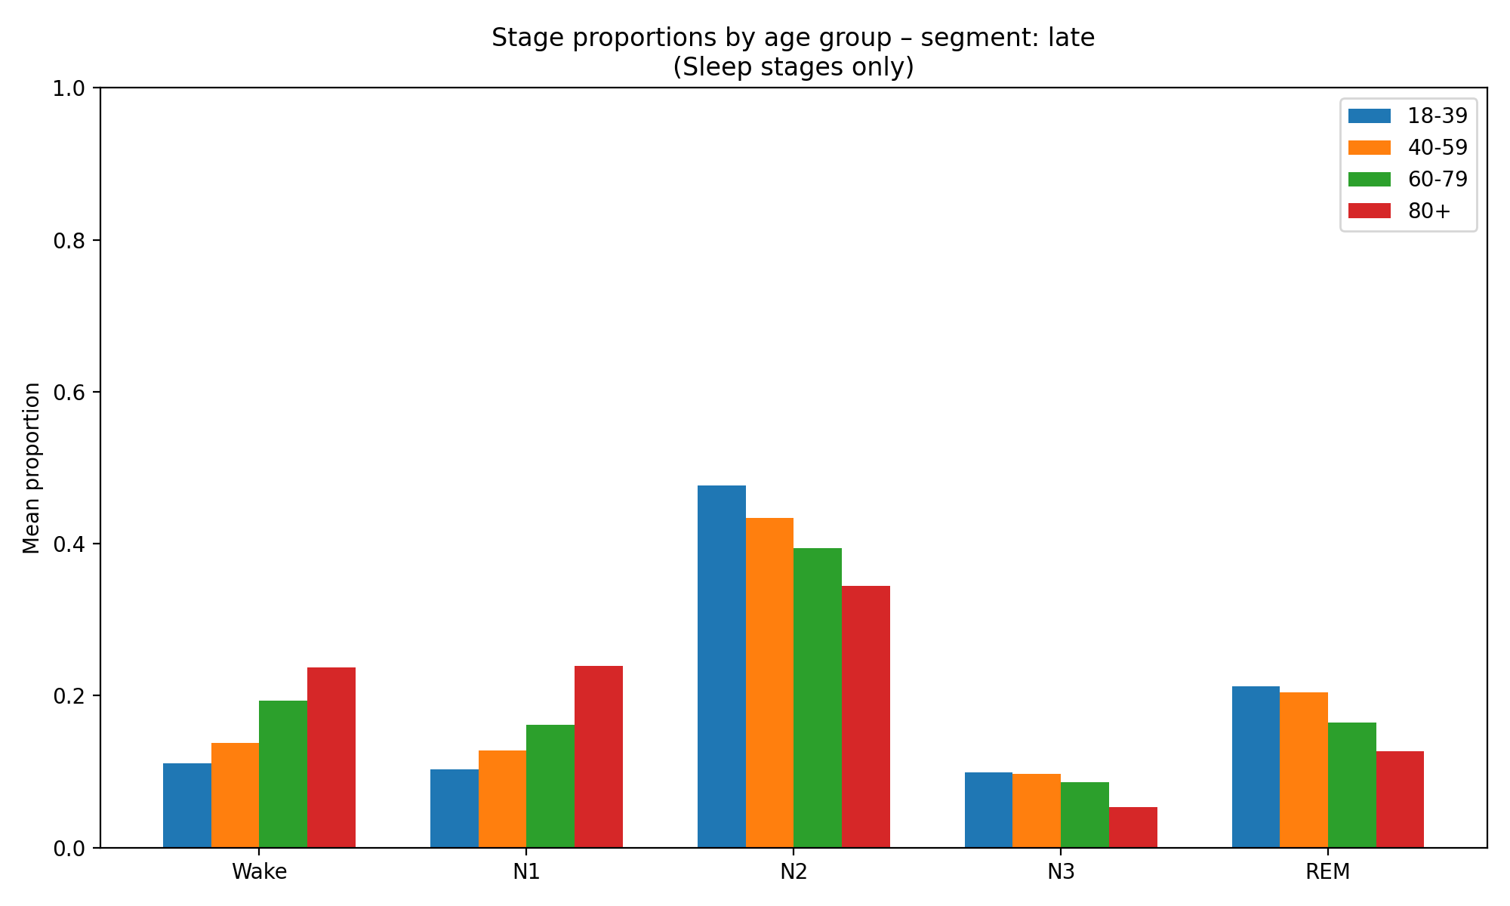
Sleep Macrostructure
Macrostructure change with Age
  Age as a Major Factor influencing Sleep Macrostructure
  As Age increases:
    Total Sleep Time decreases
    Sleep Fragmentation increases
    Deeper NREM (N3) decreases
  Observation:
  Increased proportion of Wake in the aged group, indicating greater fragmentation
  Reduction in N3, particularly during early sleep
  Age-related trends persist during late sleep as well
PhysioNet - Late
18-39 : 148 patients
40-59 : 451 patients
60-79 : 366 patients
80+ : 26 patients
= 991 Patients
Age group - Stage Proportion Plot (Late)

Slide 6
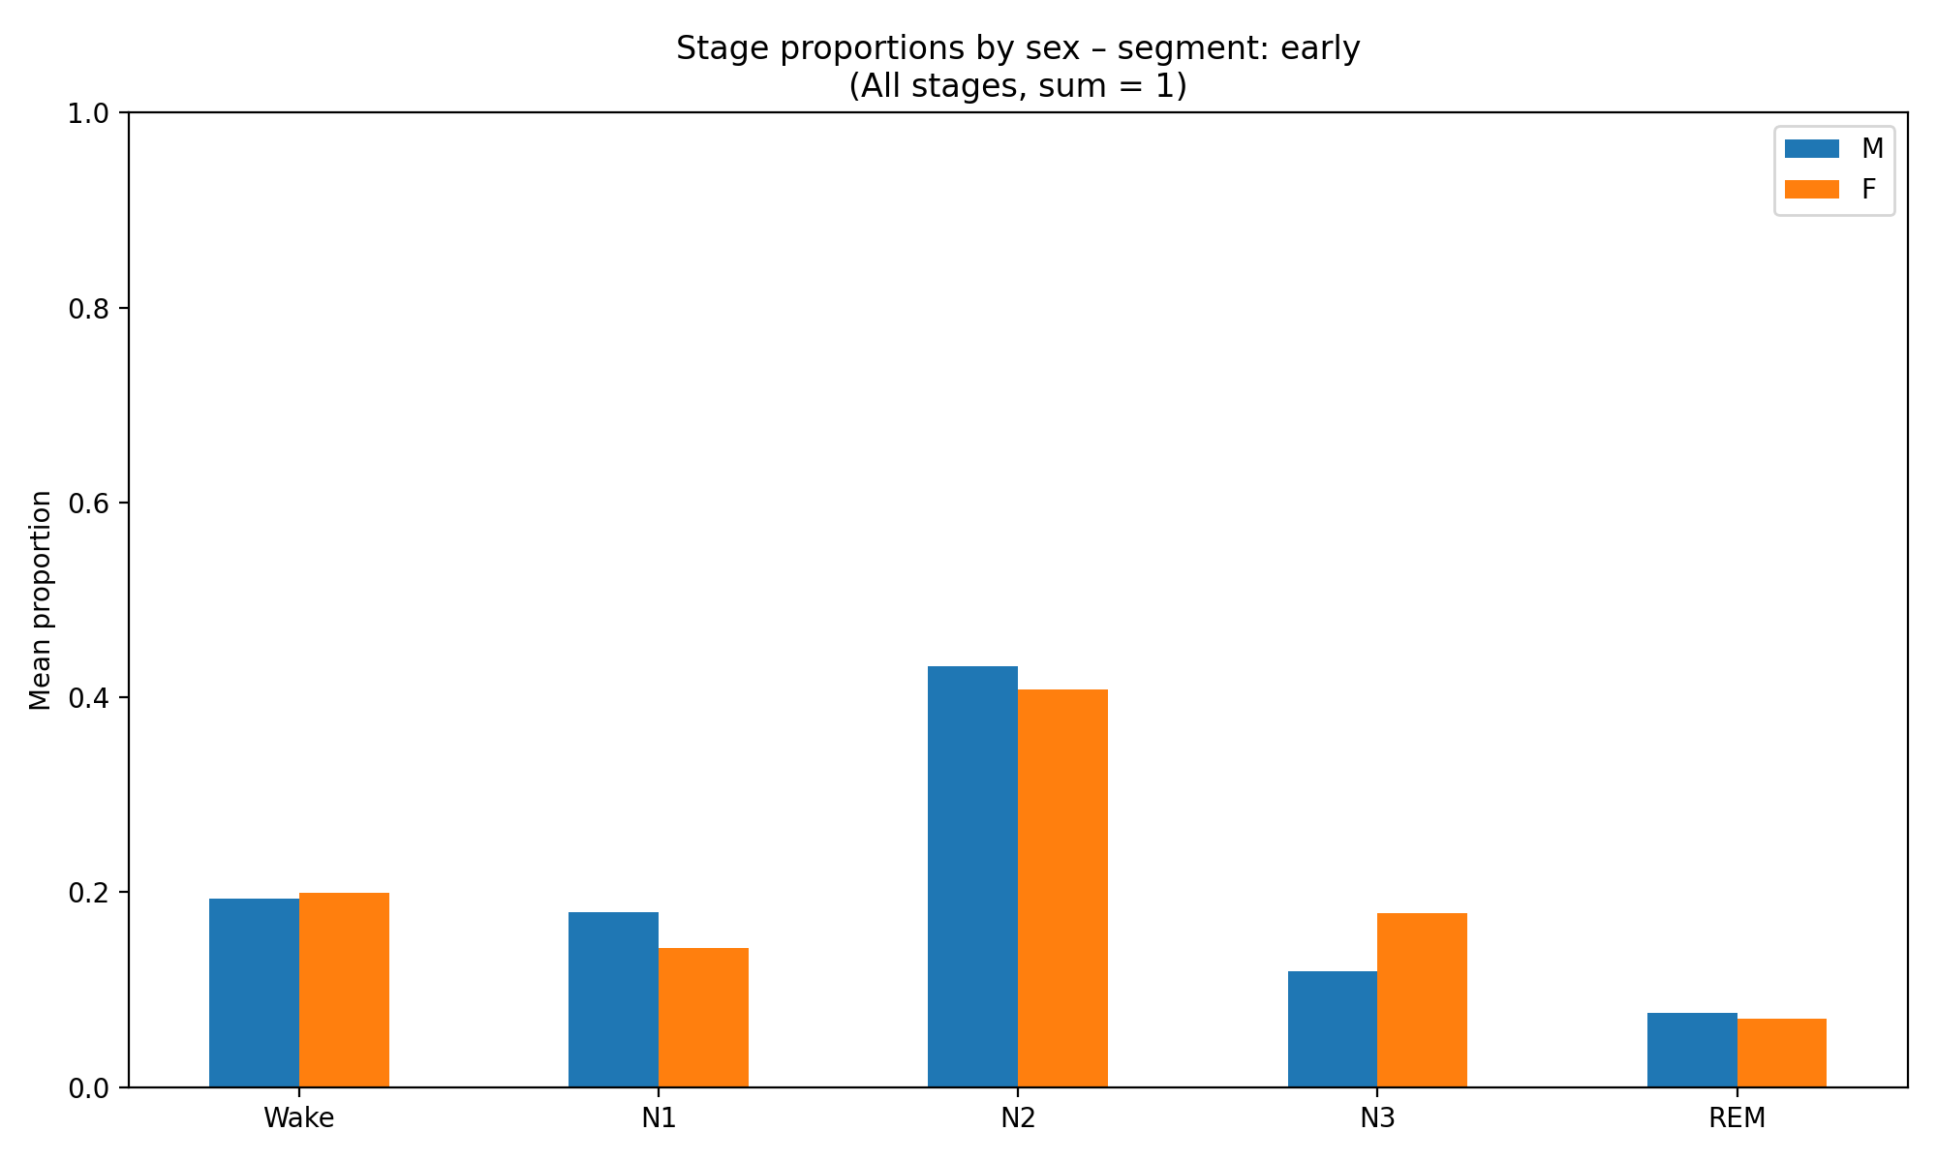
Sleep Macrostructure
Macrostructure change with Gender
  Gender influences sleep macrostructure,
  but its effect is smaller than that of age
  Gender-based patterns
    Males show lower N3 overall compared to females
    Higher proportions of Wake/N1 in males
  Observation:
  Higher N3 proportion in the female group
  Age related trends persist during late sleep as well
PhysioNet - Early
Male : 664
Female : 327
Gender group - stage Proportion Plot (Early)

Slide 7
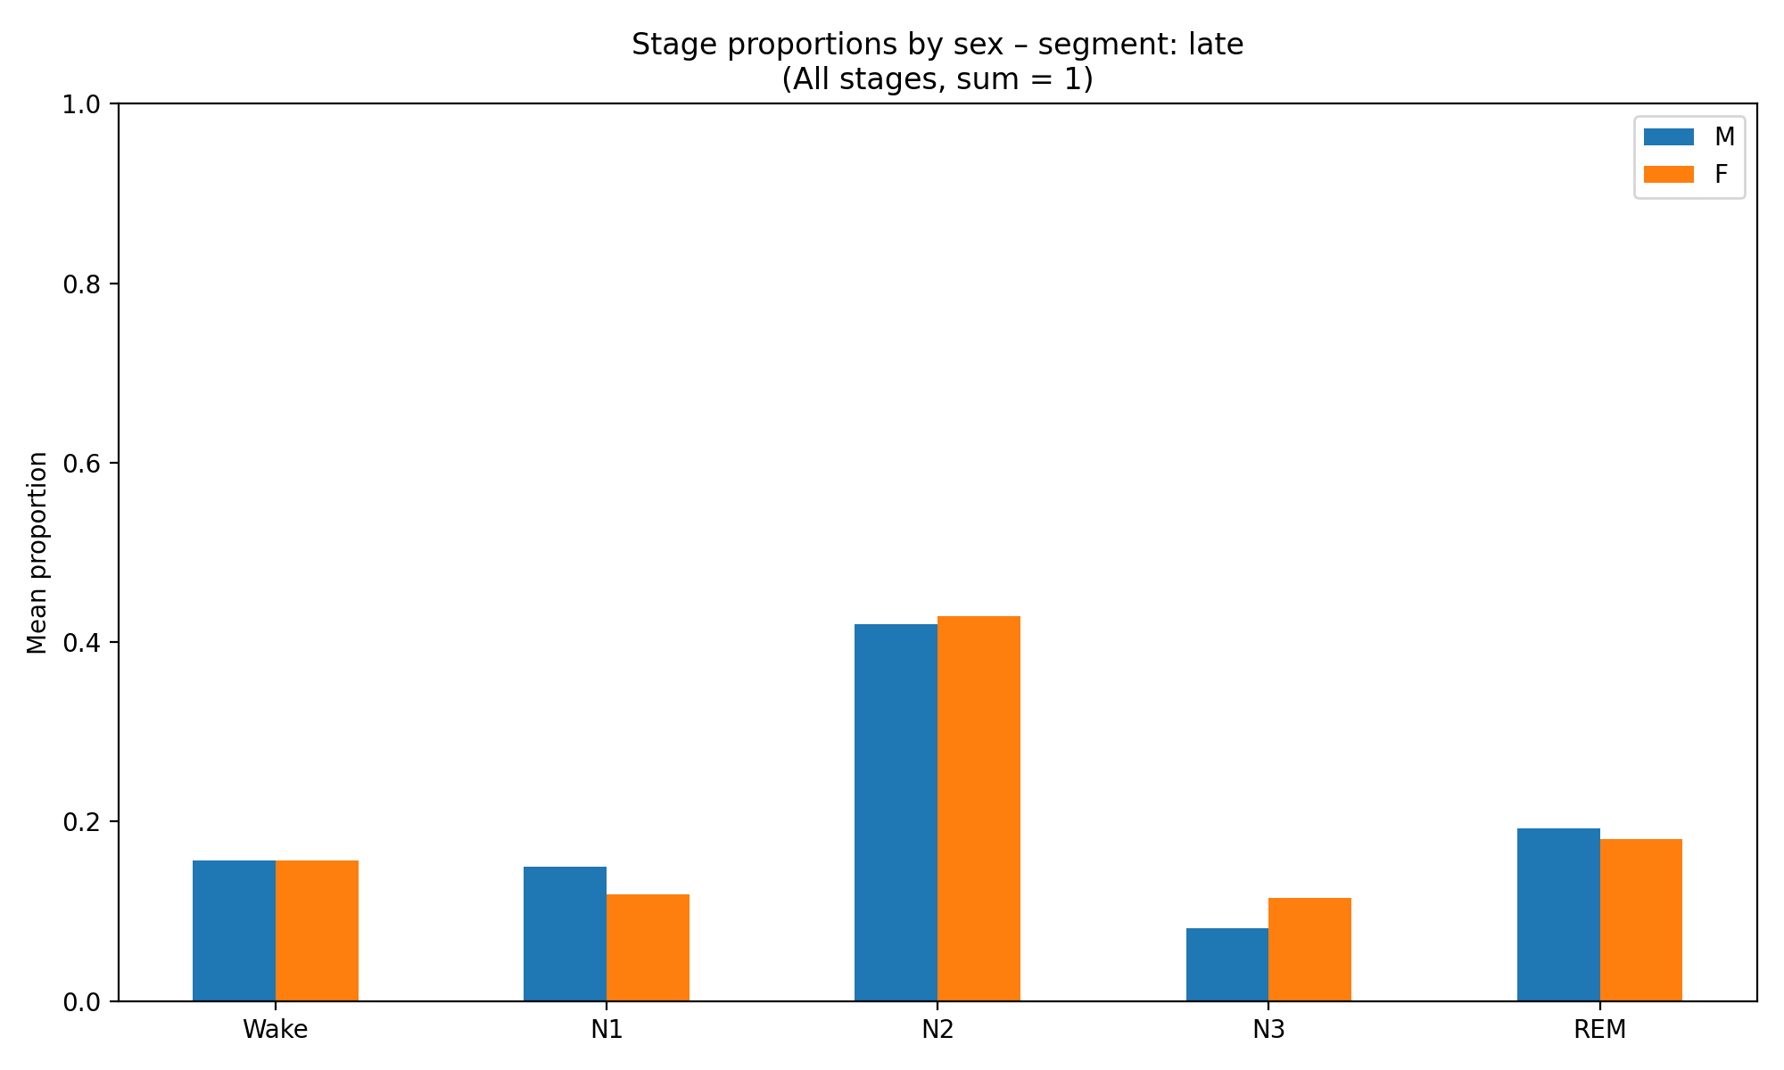
Sleep Macrostructure
Macrostructure change with Gender
  Gender influences sleep macrostructure,
  but its effect is smaller than that of age
  Gender-based patterns
    Males show lower N3 overall compared to females
    Higher proportions of Wake/N1 in males
  Observation:
  Higher N3 proportion in the female group
  Age related trends persist during late sleep as well
PhysioNet - Late
Male : 664
Female : 327
Gender group - Stage Proportion Plot (Late)

Slide 8
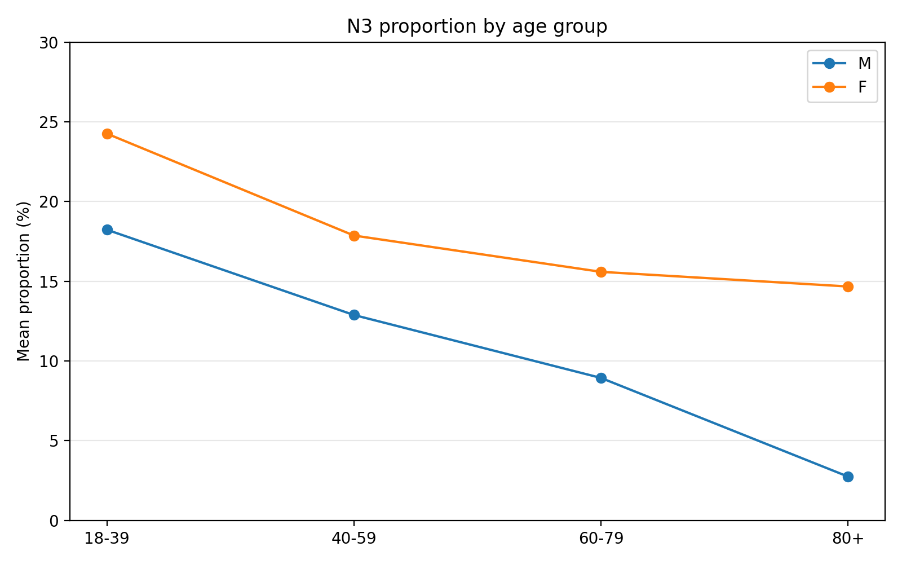
Sleep Macrostructure
Macrostructure change with Gender - 2
  Age related trends in Sleep Macrostructure by Gender
    The proportion of N3 is lower in the male group across all age groups
    A consistent age related decline in N3 is observed
    This decline becomes more pronounced in older age groups
  Observation:
  N3 proportion decreases with age
  Female Group shows a slightly higher N3 proportion compared to males
PhysioNet - Early
Age-Gender N3 Proportion Plot (Early)

Slide 9
Sleep Macrostructure
Sleep Macrostructure - Takeaways
  Higher N3 proportion during early sleep, with a tendency for REM proportion to increase during late sleep
  Age – the strongest demographic factor influencing macrostructure
  With increasing age:
  - Decrease in deep NREM sleep (N3)
  - Increase in sleep fragmentation
  Gender – smaller effect compared to age
  - Lower N3 proportion in the male group across all age ranges
  - Differences become more pronounced in older adults

